Slide 1


MovieMonk Your own booking platform!
Ayushi Choudhary
Harsha Wardhan Reddy
Pragyan Sharma
Pratik Khandelwal

Slide 2

Agenda
Introduction
Data pipeline and architecture
Schemas (OLTP, ODS, WH)
Business Metrics (Tableau)

Slide 3



MovieMonk
Your own movie booking station
Founded Since 2018
Online movie booking aggregator system that allows movie bookings at theaters across multiple locations.
Customers
One-stop solution for bookings and cancellation.
Access to information: top movie releases, viewer ratings etc.
Opportunity to save costs by applying promos and offers.
Theaters
Access to measure and analyze performance across all registered locations on different levels including customers, movies etc.
MovieMonk Analysis
Access to analyze key business metrics such as revenue generated from theaters and customers, performance and prediction on an annual/monthly/weekly basis, etc.

Slide 4

Data Pipeline
Data flow for MovieMonk
OLTP and other sources
Data Warehouse (WH)
Transactional data from multiple sources (CSV, JSON)
Analytical processing; dimensional data models
Operational Data Store (ODS)
ANALYTICS
Extraction and transformation of data
Tableau based business metrices for data description and prediction

Slide 5
Data Architecture
Data stages for MovieMonk
Heterogeneous Sources
Staging/ODS
Data Warehouse
BI
Applications
MovieMonk DB
MovieMonk ODS
MovieMonk OLAP
Internal Sources
Reports
EXTRACT
Tables
CSV (Date)
LOAD
Dimensions, Facts
Tableau
Other DB Objects
JSON (Movies)
External Sources
TRANSFORM

Slide 6
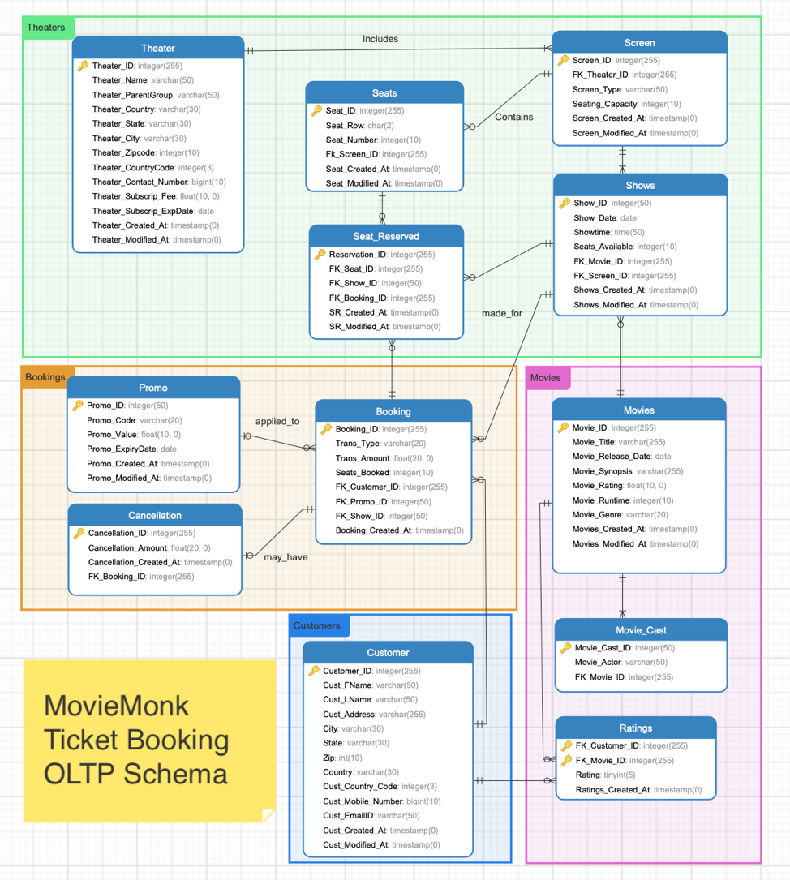
Schemas
OLTP SCHEMA
ODS SCHEMA
Multimedia
12 Entities
6 Entities related to bookings

Slide 7
Schemas
OLAP SCHEMA
Star Schema
5 Dimension tables
1 Fact table
Multimedia

Slide 8
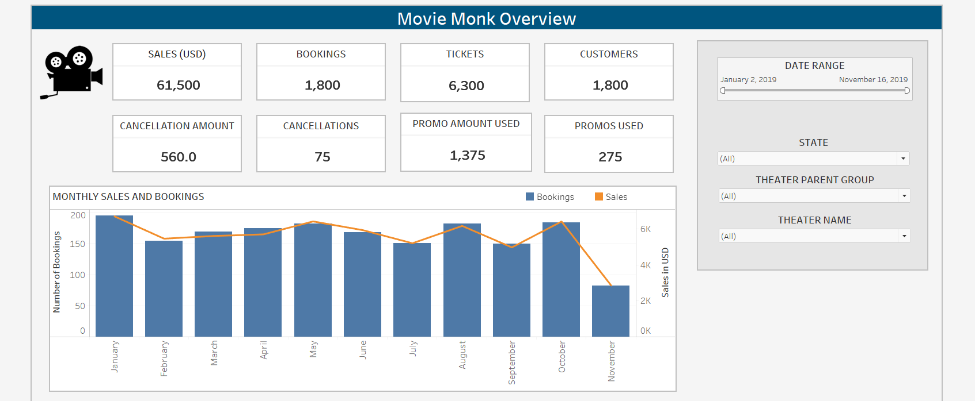
MovieMonk Descriptive Analysis

Slide 9
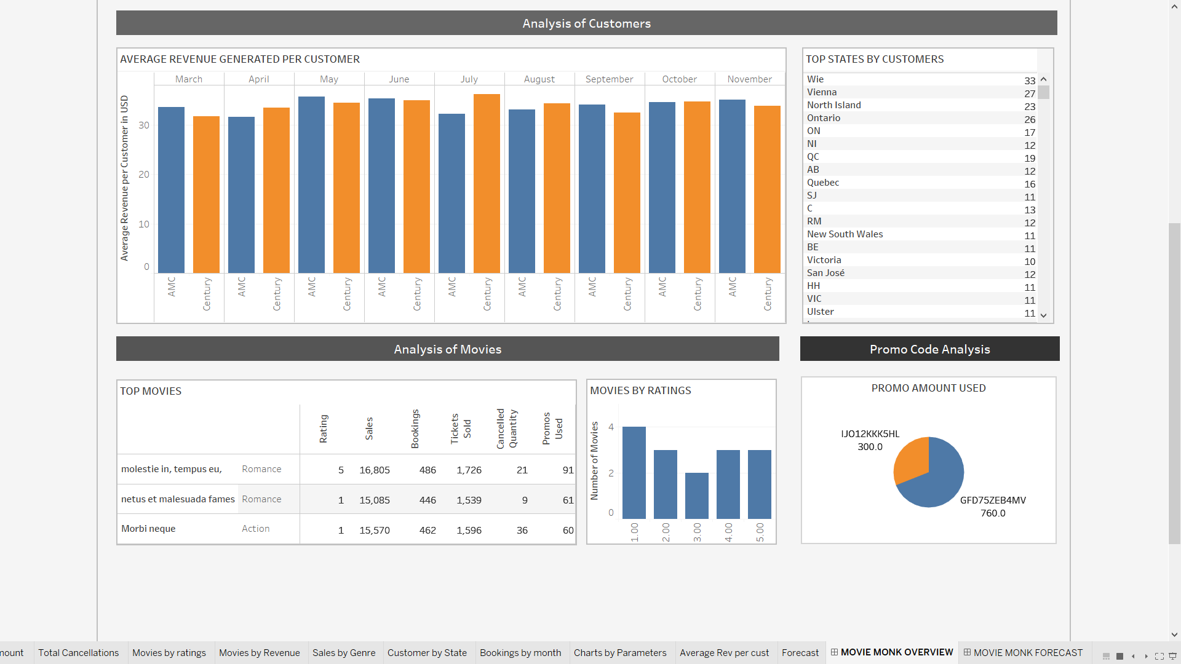
MovieMonk Descriptive Analysis

Slide 10
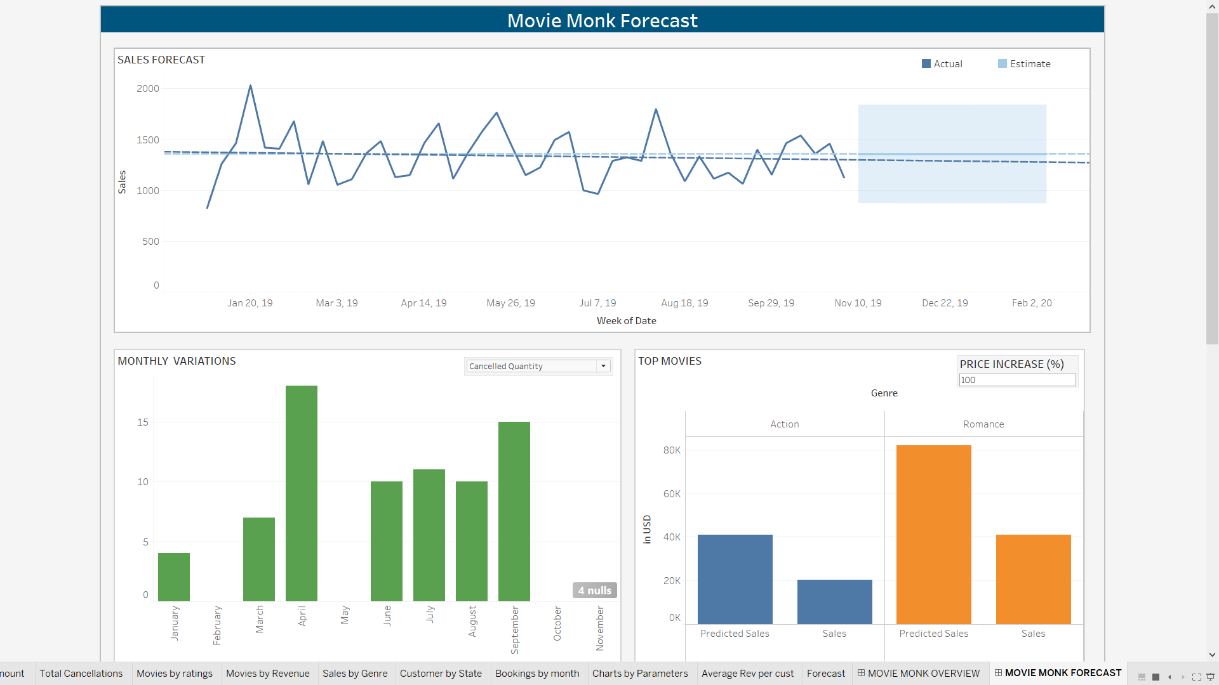
MovieMonk Predictive Descriptive

Slide 11
Thank You

Slide 12
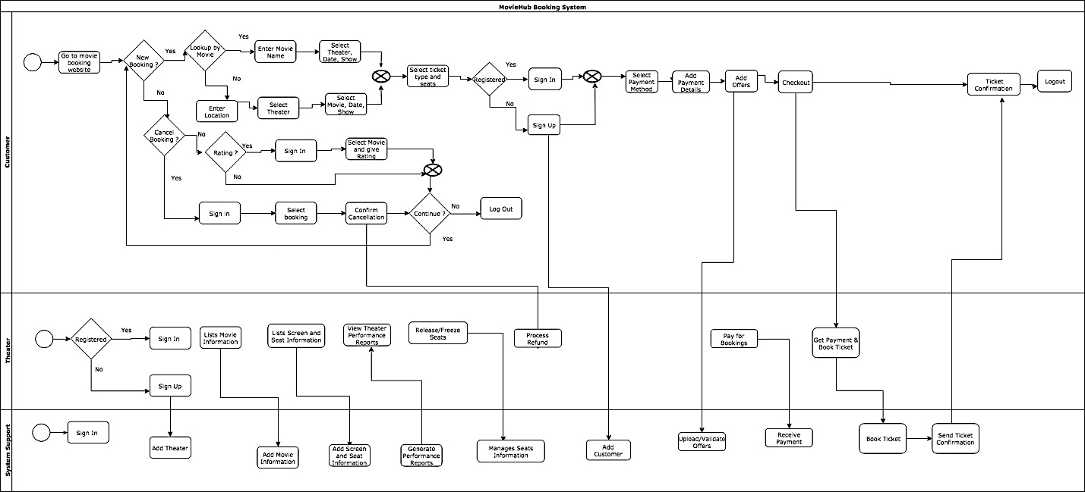
Appendix: Swimlane

Slide 13
Appendix : OLTP Schema

Slide 14
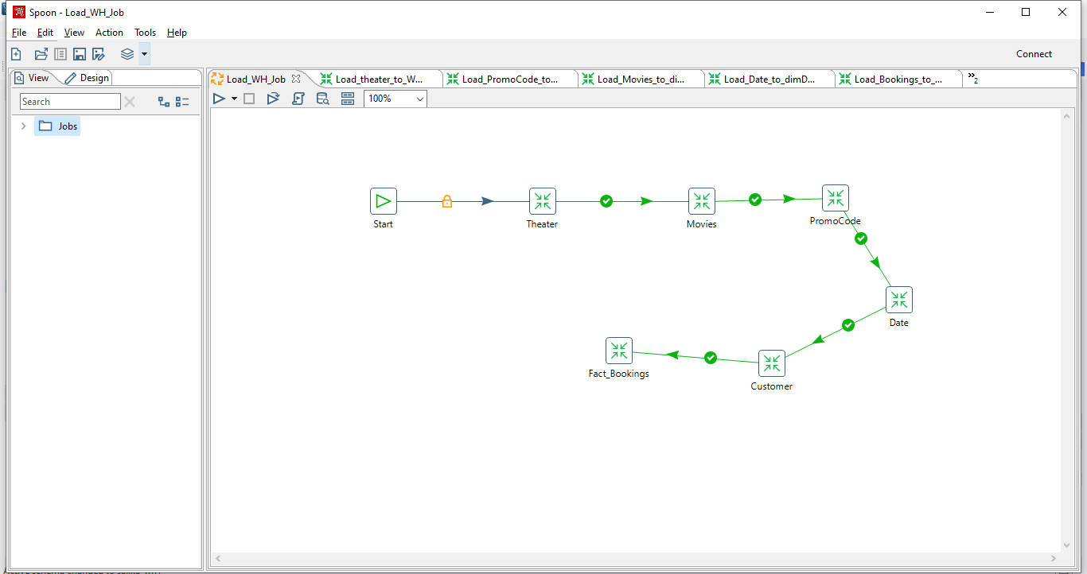
Appendix : Pentaho Warehouse Job

Slide 15
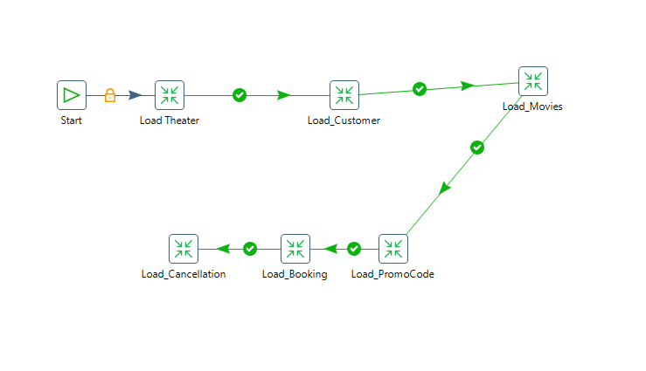
Appendix : Pentaho Warehouse Job

